Slide 1
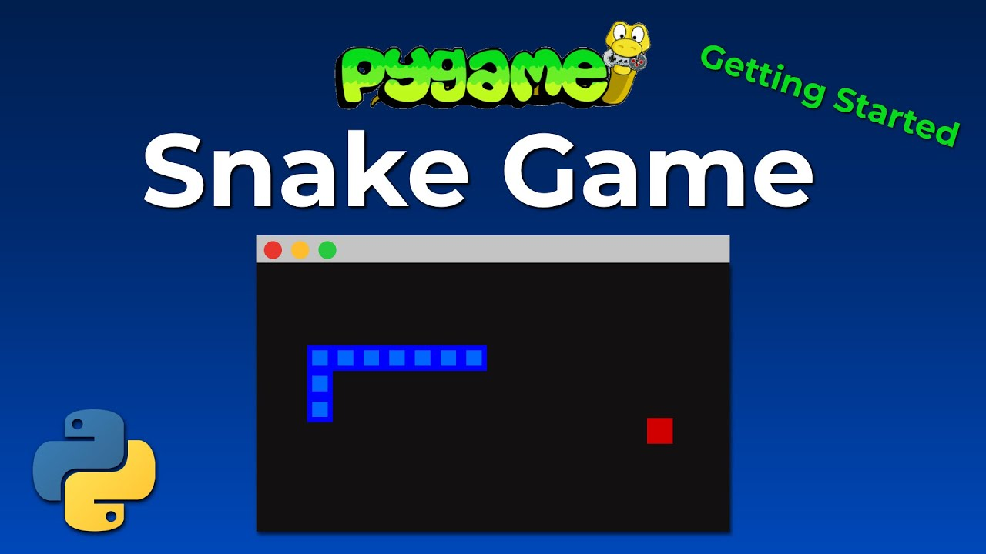
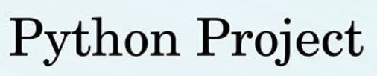

Slide 2
Code Logic
1. Initialization:
Pygame is initialized with pygame.init().
2. Colors and Window Dimensions:
Colors are defined using RGB tuples.
Window dimensions are set for the game window.
3. Game Window:
The game window is created using pygame.display.set_mode().
4. Snake Properties:
snake_size and snake_speed define the size and speed of the snake respectively.

Slide 3
5. Fonts:
Fonts are defined for rendering text on the screen.
6. Function Definitions:
render_score(): Renders the current score on the screen.
draw_snake(): Draws the snake on the screen.
display_message(): Displays messages on the screen.
game_loop(): The main game loop that controls the game logic.
7. Main Game Loop:
This loop runs until the game is over.
It handles events such as key presses and window close events.
It updates the snake's position, checks for collisions, and draws everything on the screen.
The frame rate is controlled with pygame.time.Clock().tick().
8. Game Over Handling:
The game loop ends when game_over becomes True.
Pygame is quit and the program exits when the game is over.
This code sets up a simple Snake game where the player controls the snake to eat food and grow in size while avoiding collisions with the boundaries or itself.

Slide 4


